Slide 1

Timetabling in Academic Institutions problem using genetic Algorithms
Florentin Niyongere

Slide 2
Description
It is a generalization of the Travelling salesman Problem (TSP)
Can also be referred as the vehicle routing problem (VRP)
TSP
Single Travelling Salesman
MTSP
Multiple Travelling Salesman

Slide 3
Applications
Crew Scheduling
Vehicle Routing
Order-picking in warehouse

Slide 4
Heuristics
Simple greedy algorithm
Each salesman get to visit the closest unvisited city.

Slide 5

Chromosome Structure
Array of K integer
It is divided into two parts
Example of a chromosome:
Number of cities = 11
Number of Salesman = 3

Slide 6
Crossover
Modified Order Crossover
Divide parent into two parts
Right part copied
Same steps as order crossover.

Slide 7
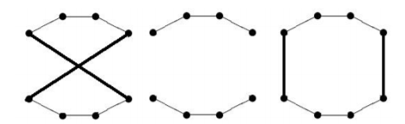

Mutation
Two steps mutations
Two points randomly selected and replaced or reversed
The 2-opt heuristic is used to improve the route which replaces two non-adjacent edges by two other edges.
AND

Slide 8
Results
CBKS | GA | MACA | Instance
157444 | 157440 | 178597 | Pr76
127839 | 127842 | 130953 | Pr152
166827 | 166825 | 167646 | Pr226
382198 | 382189 | 382198 | Pr1002
Problem instances source: https://www.iwr.uni-heidelberg.de/groups/comopt/software/TSPLIB95/XML-TSPLIB/instances/

Slide 9
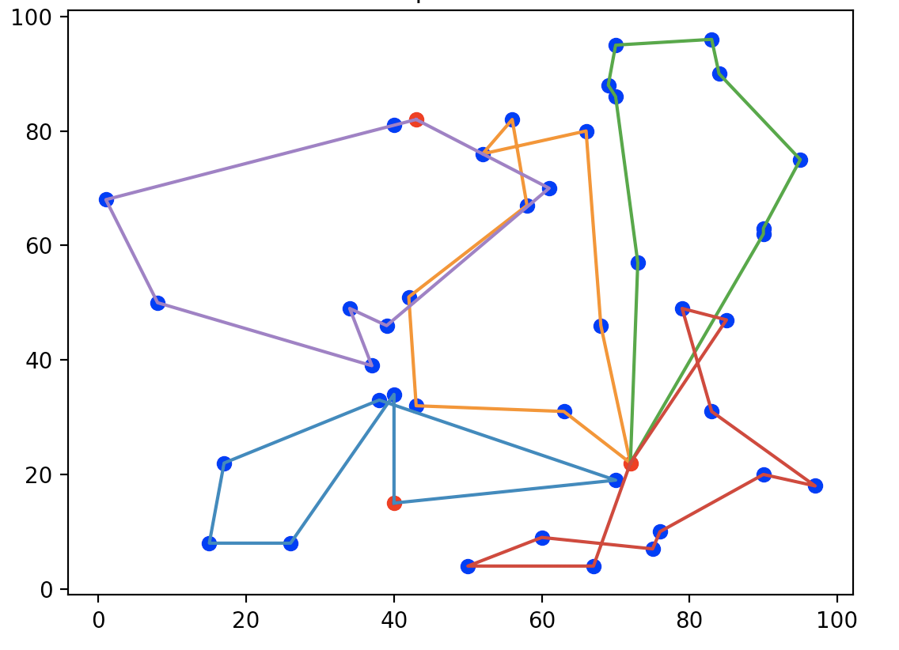
Example of a run.

Slide 10
Some improvements
Keep track of the salesman part of the array.
Adjust to the modification of the new chromosomes.
Adding another heuristics to the GA.

Slide 11
Conclusion
The problem was analyzed though a greedy heuristics, a Hybrid GA and A modified Ant Colony Algorithm.
The GA was able to perform slightly better than the heuristics
Better performance by the Hybrid GA compared to the modified Ant Colony Algorithm.

